Slide 1
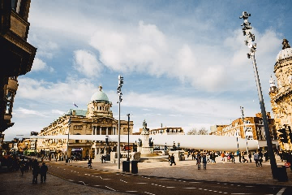
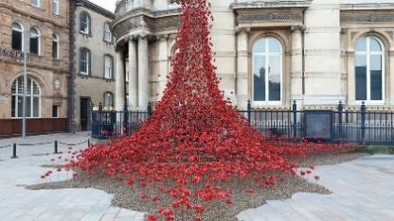
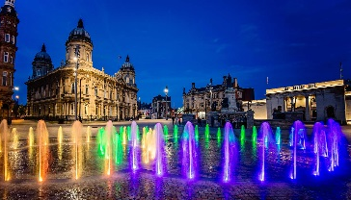
Q13 Have you ever been to Hull City Centre and seen any of these?
Blade
Poppies / Weeping Window
Fountains

Slide 2
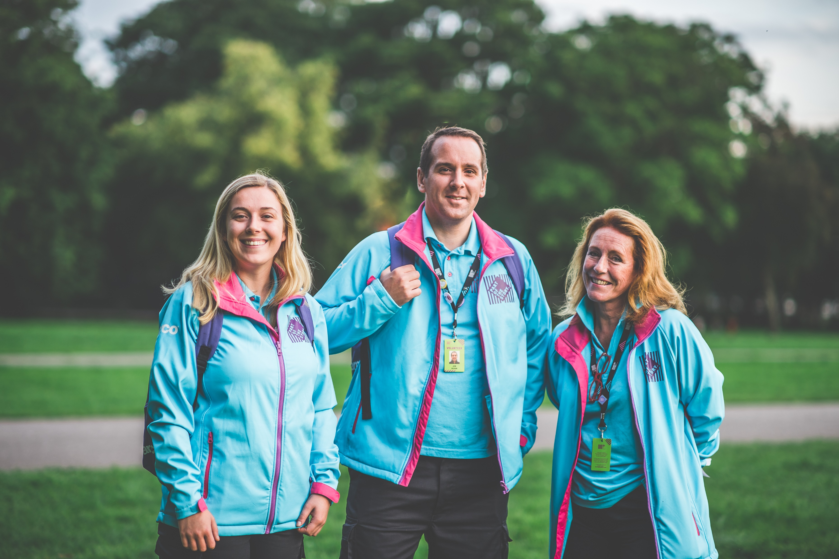
Q14 Have you met or spoken to a Hull 2017 volunteer?

Slide 3
Q15 Have you had any of these Hello Hull issues?

